Slide 1
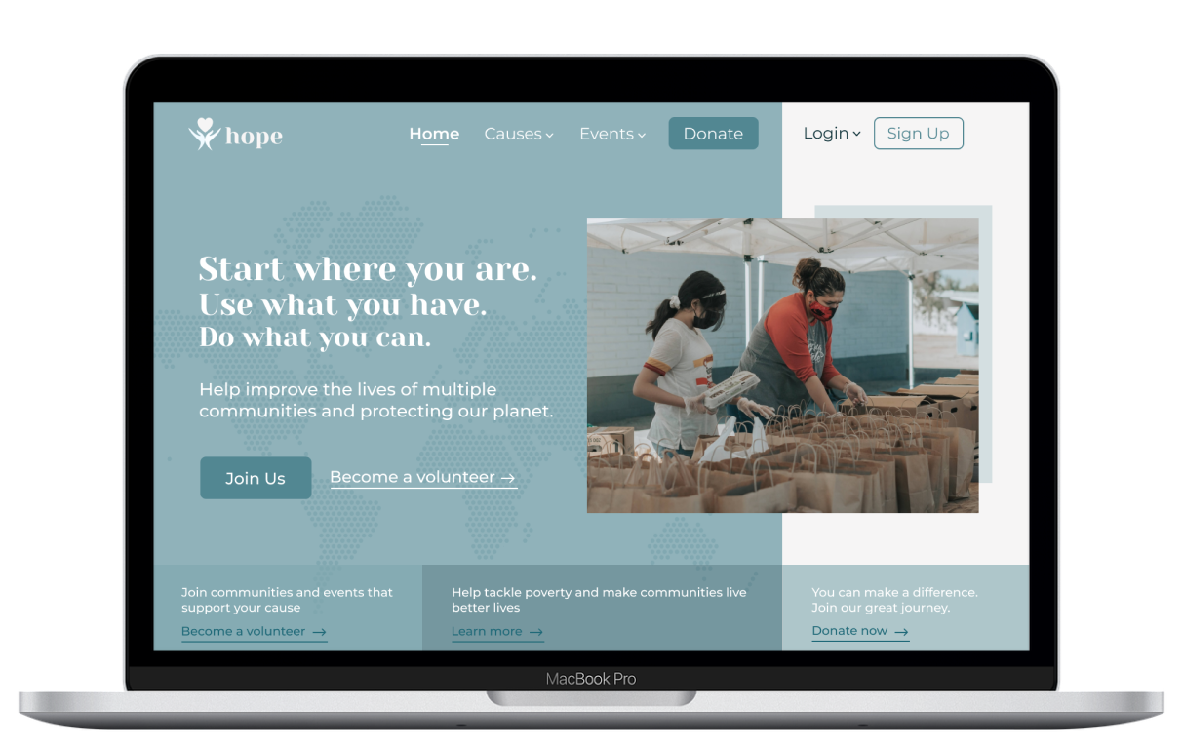

Introduction to
Human-Computer Interaction
Product Development Project
Final Presentation
Presented By : Saumya Roy, Evis Shehu, Femina Baldha, Vidisha Sawant, Hema Sree
Volunteer and Donation Website

Slide 2

01
Introduction
04
02
Table of Contents
Usability Study
User Research
05
03
Conclusion
Sitemap & Prototypes

Slide 3

INTRODUCTION
The Problem
People want to have a part in the causes they support
Lack of credibility of the organization.
Find a credible organisation or a platform which can help individuals to search causes
Find a platform that allows people to participate in volunteering events
Find events that fit into people’s busy schedules
Organizations can’t find the right people to support their causes

Slide 4

INTRODUCTION
Our Goal
Design a website to help people to find and join volunteering events and groups around them. Hope aims to solve the problem of credibility and finding events and donation drives in one place, with simple navigation and detailed information.
Project Description
“Hope” is a website for a non profit organisation which helps people to join volunteer groups and events around them.
Helps people to search and join volunteer events
Assists people who want to donate
Allows organizations to advertise their events, recruit and manage volunteers

Slide 5
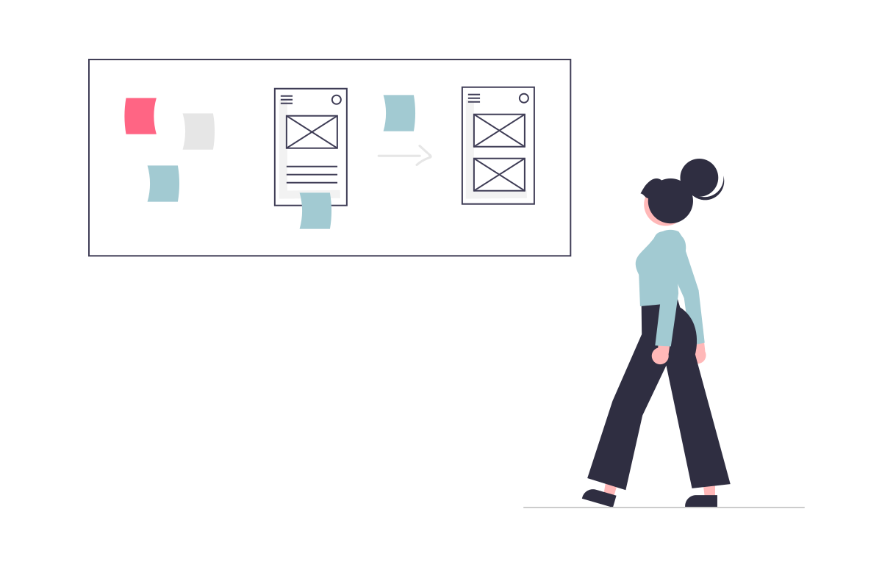
INTRODUCTION
Design Process
User Research
Interviews
Personas
Ideation
Sitemap
Paper Prototypes
Prototype
Visual Design
Interactions
Test
Usability Test
Iterations

Slide 6

USER RESEARCH
Data Collection
01
We aimed to understand people, how they volunteer for a cause, how often they donate and how much they are willing to help.
Volunteers
We aimed to understand how organizations reach to possible volunteers, recruit, and manage them.
How to maintain an on ongoing communication and involvement that would keep volunteers engaged in the long run.
02
Organization

Slide 7
USER RESEARCH
Interview Insights
Problems people face with finding relatable causes
Lack of information on events and donation drives
Awareness of the platforms available
01
Volunteers & Donors
Pain point - credibility or authenticity of the organization
02
How organizations communicate volunteering needs and events
How they recruit people
Find the right people for the role
Volunteer Empowerment and recognition
Organization
Pain-point - to encourage long term involvement

Slide 8
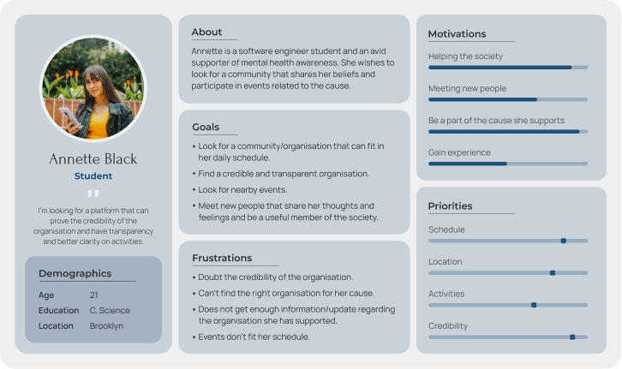
USER RESEARCH
Persona 1

Slide 9
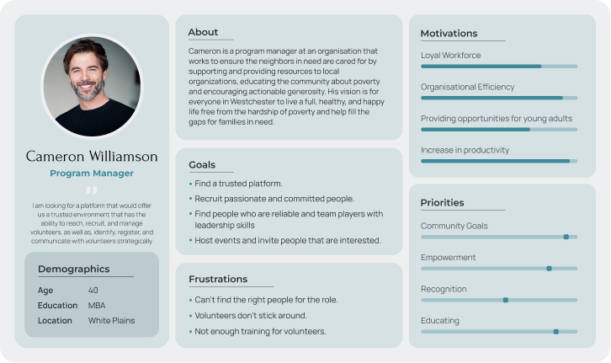
USER RESEARCH
Persona 2

Slide 10
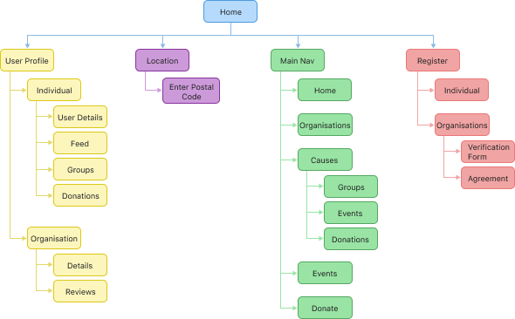
SITEMAP & PROTOTYPES
Sitemap

Slide 11
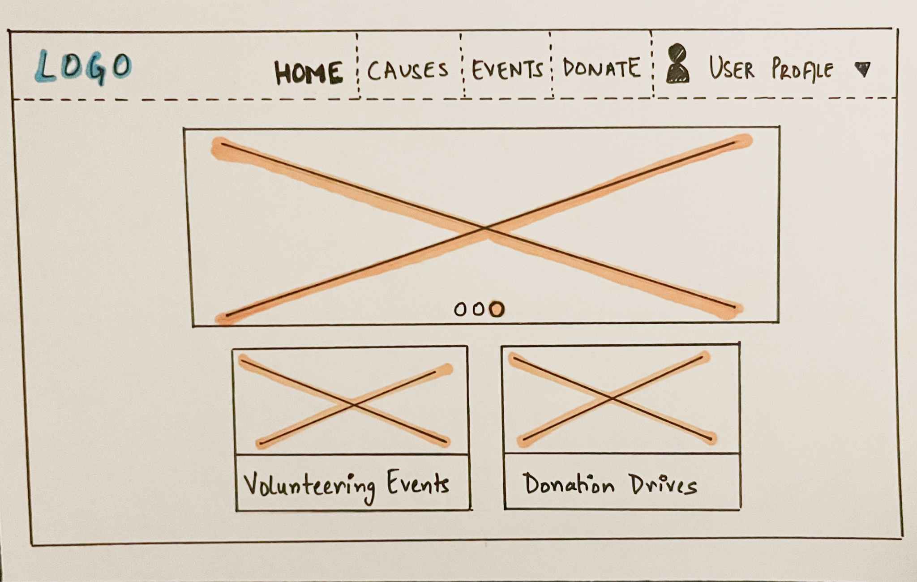
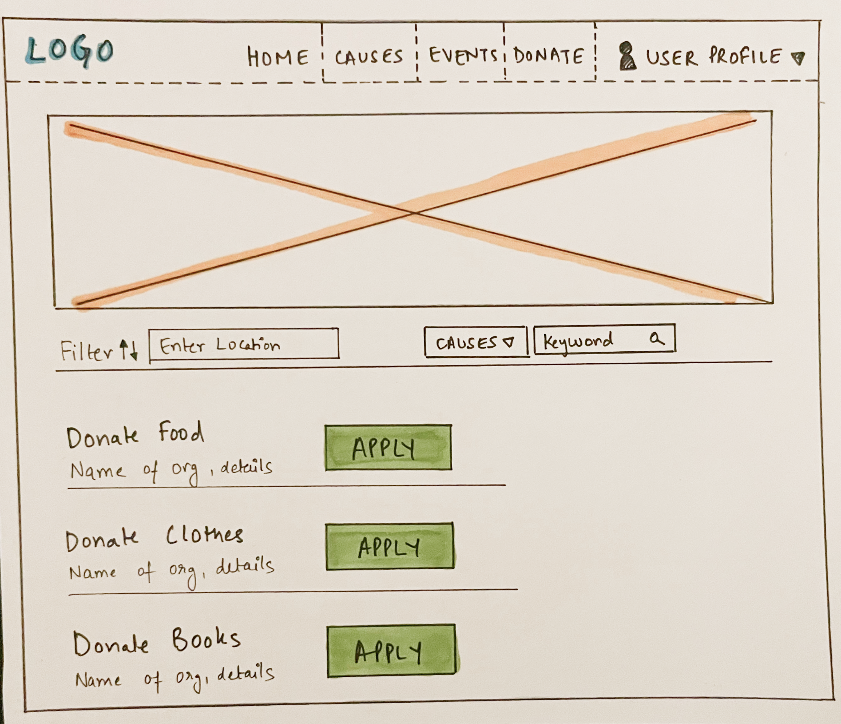
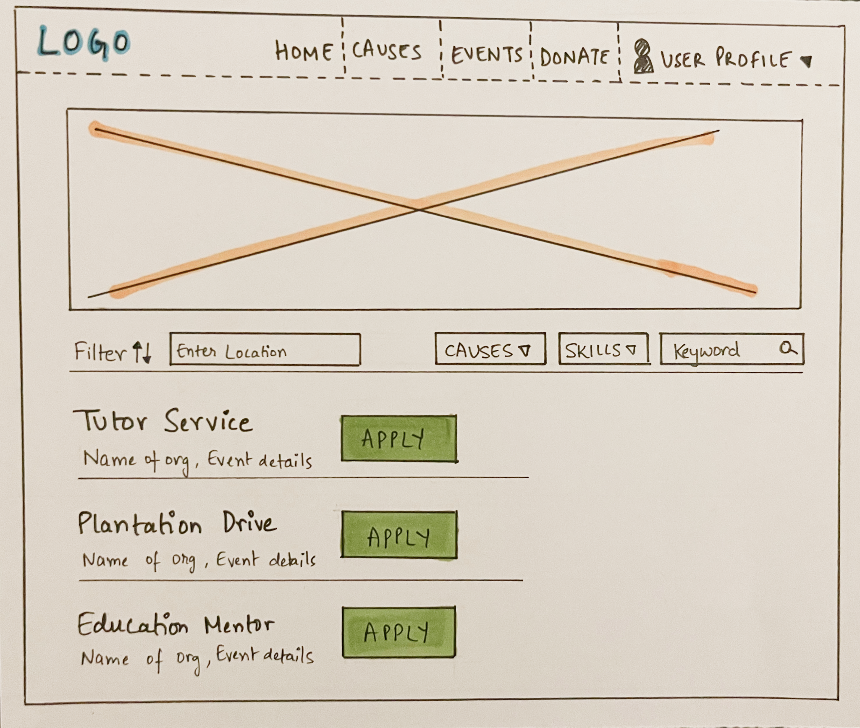
SITEMAP & PROTOTYPES
Paper Prototypes
Home Screen
Donation Drives
Volunteer Events

Slide 12
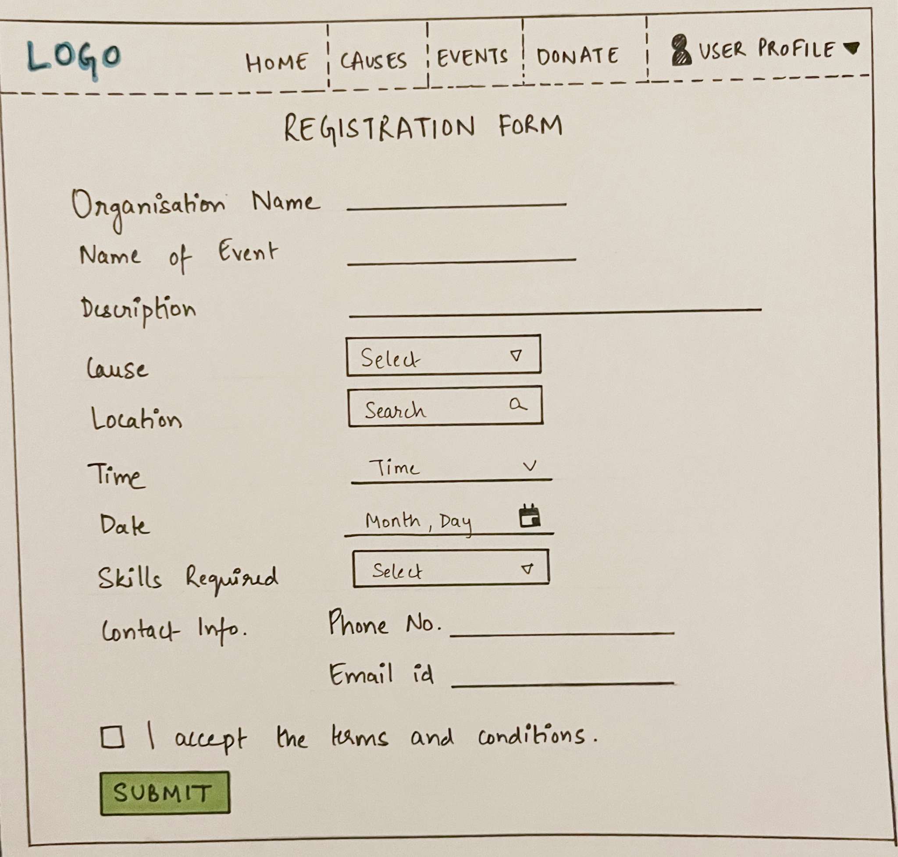
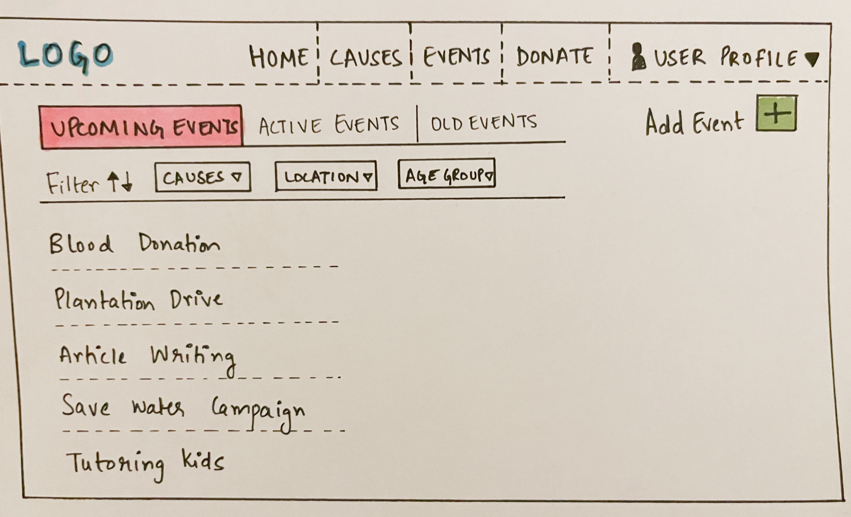
SITEMAP & PROTOTYPES
Paper Prototypes
Organisation Dashboard
Event Registration

Slide 13
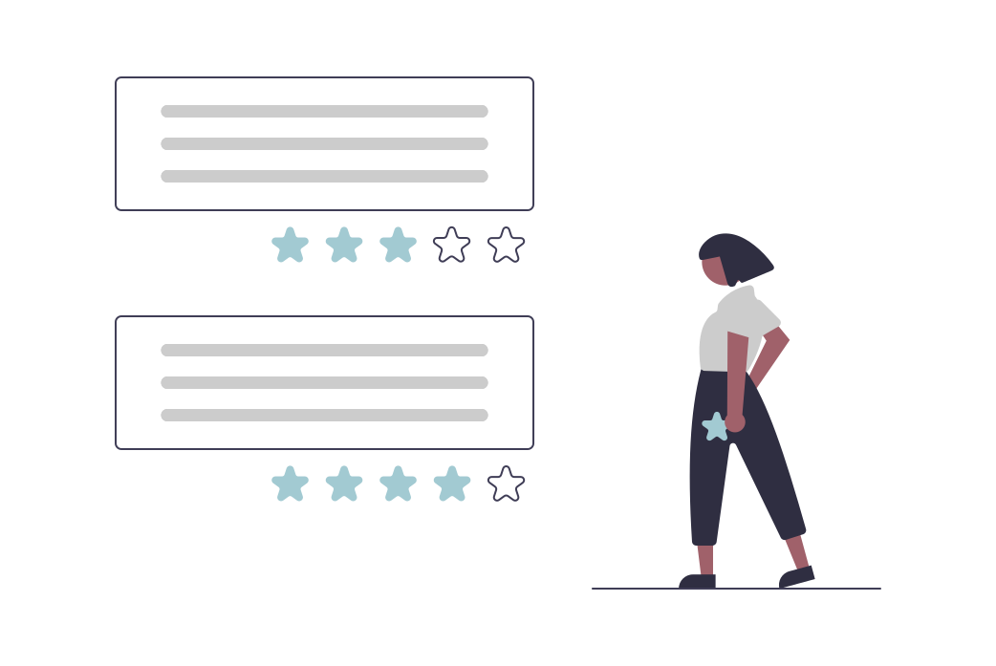
SITEMAP & PROTOTYPES
Feedback from Users & Potential Changes
There should be an option of anonymous donation.
In the filter, the user should get an option to filter the organization.
A short description of the volunteering events should be added.
Next to the “Apply” or “Donate” buttons, add a “Contact” button, so that users can reach out to the organization for further details should they want to do so
In the list of events, next to Event Name, make visible the Cause the event is supporting.
In the end page, organizations should have an option where some KPIs are highlighted such as how many people have signed in for volunteering, or how many donations have been collected towards the goal

Slide 14

SITEMAP & PROTOTYPES
Figma Prototypes
Core Tasks :
Register for an education mentor volunteer event
Make a $50 donation anonymously
Login as an organisation and add a new event

Slide 15
SITEMAP & PROTOTYPES
Figma Prototypes
Home Screen

Slide 16
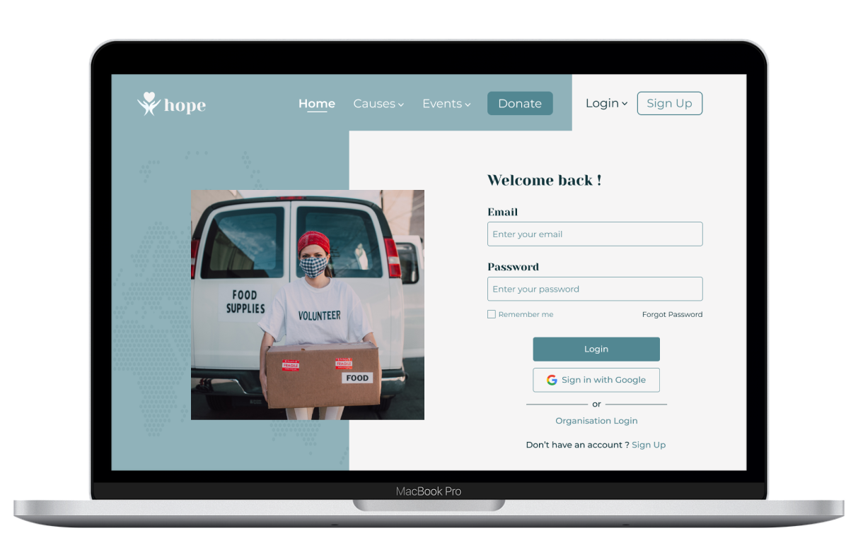
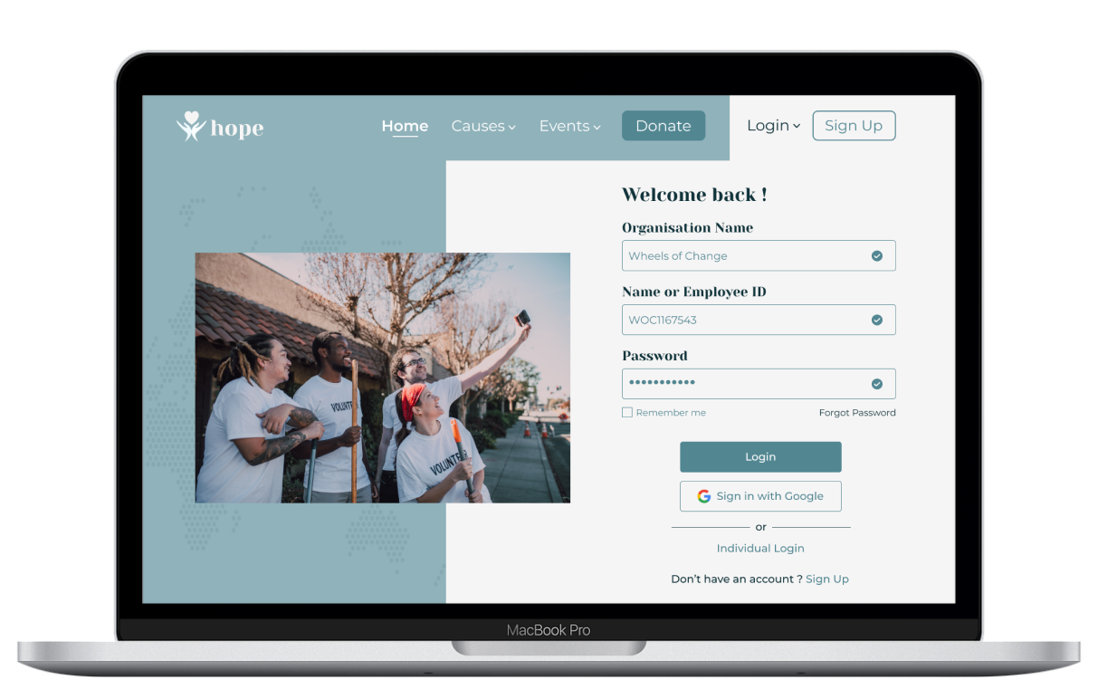
SITEMAP & PROTOTYPES
Figma Prototypes
Individual Login
Organisation Login

Slide 17
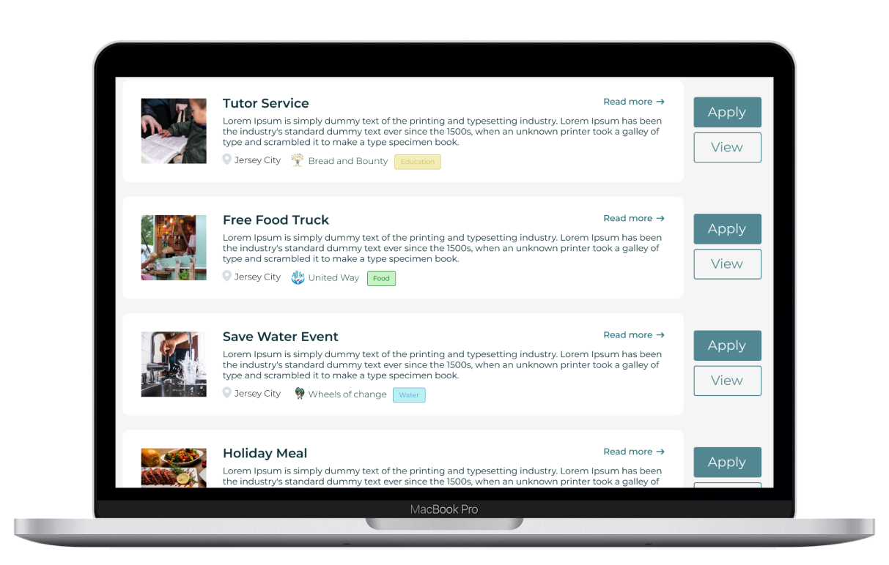
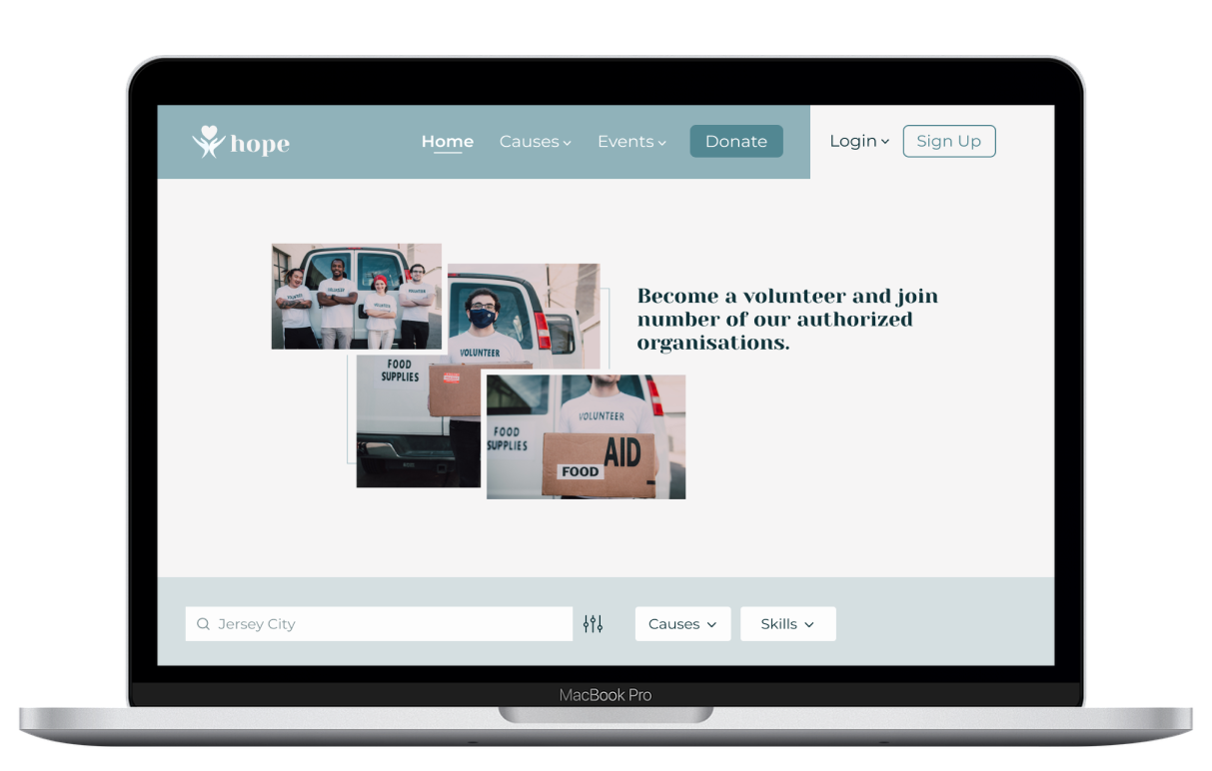
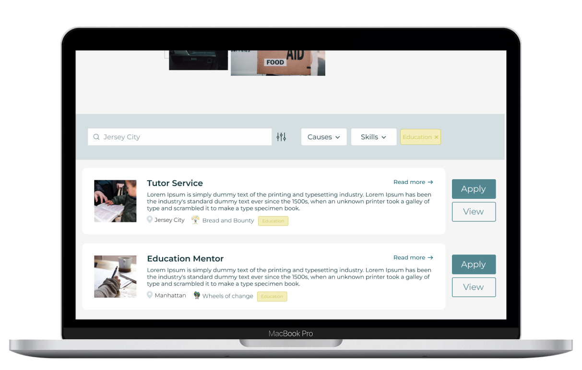
SITEMAP & PROTOTYPES
Figma Prototypes
Volunteer Events

Slide 18
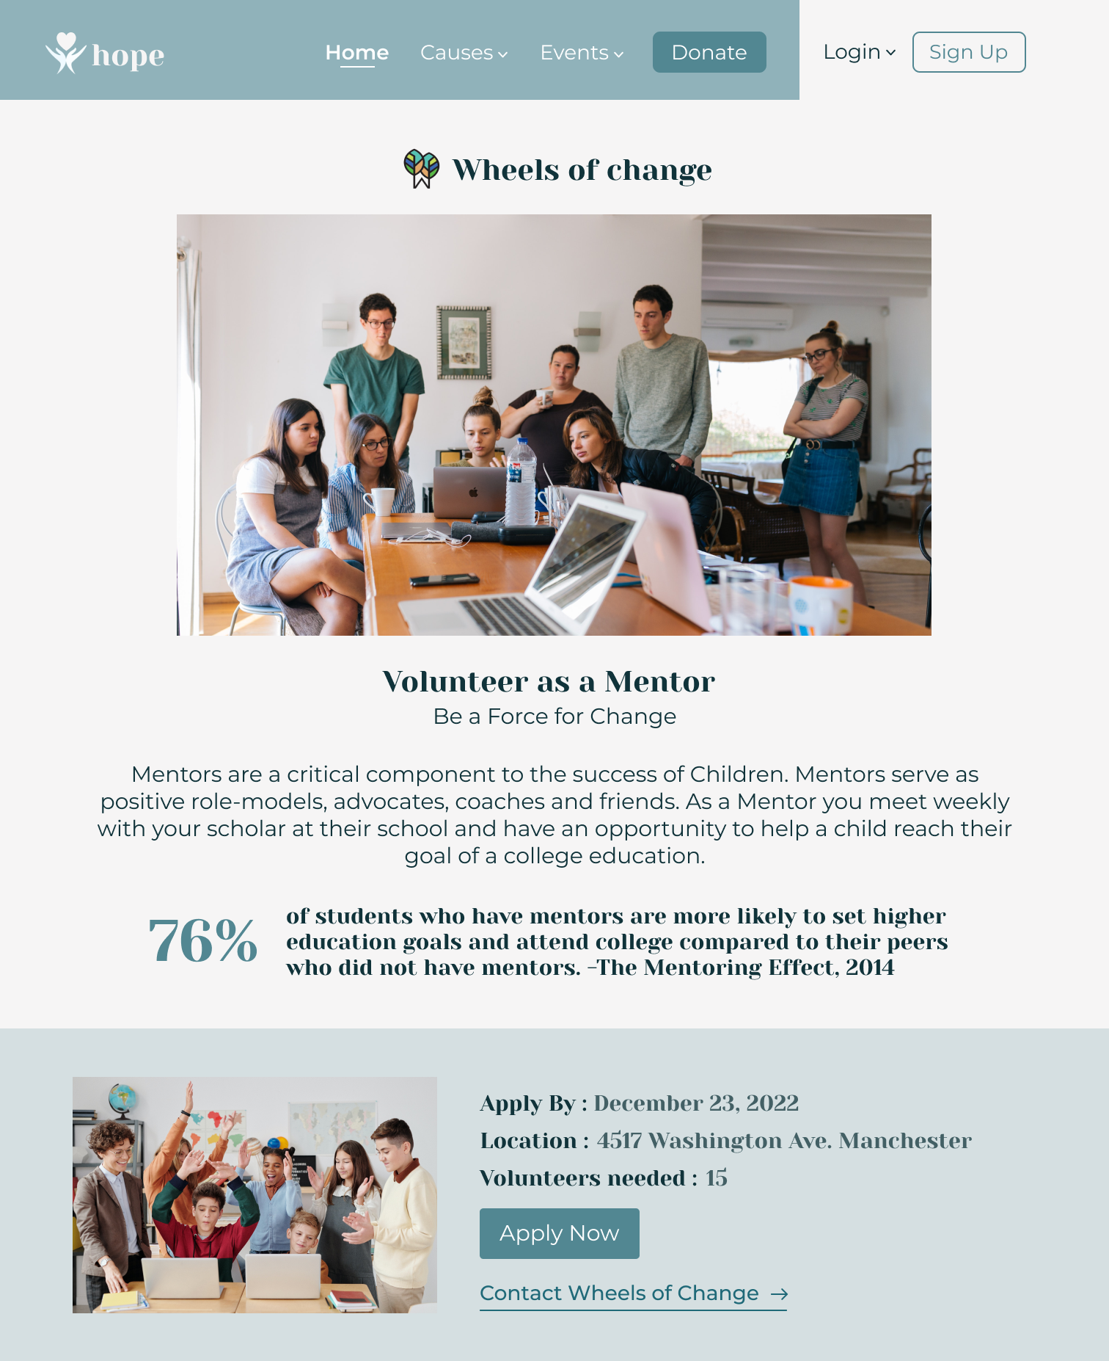
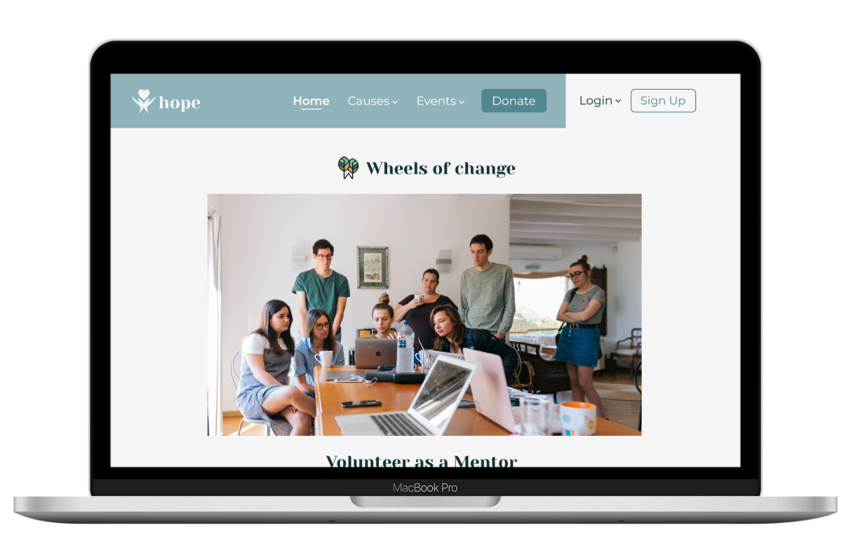
SITEMAP & PROTOTYPES
Figma Prototypes
Event Page

Slide 19
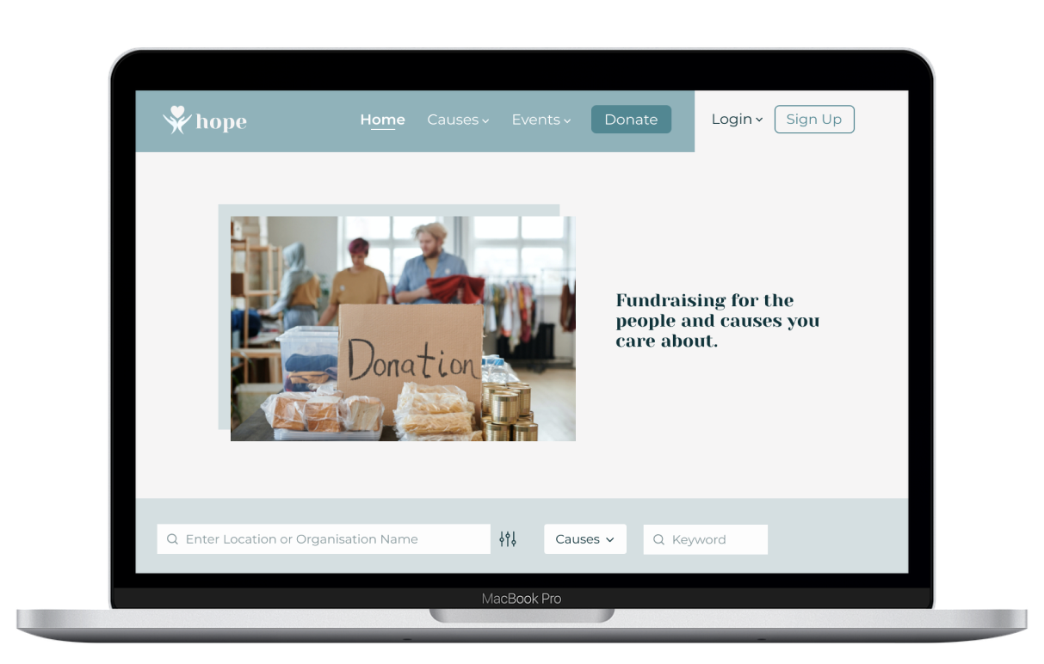
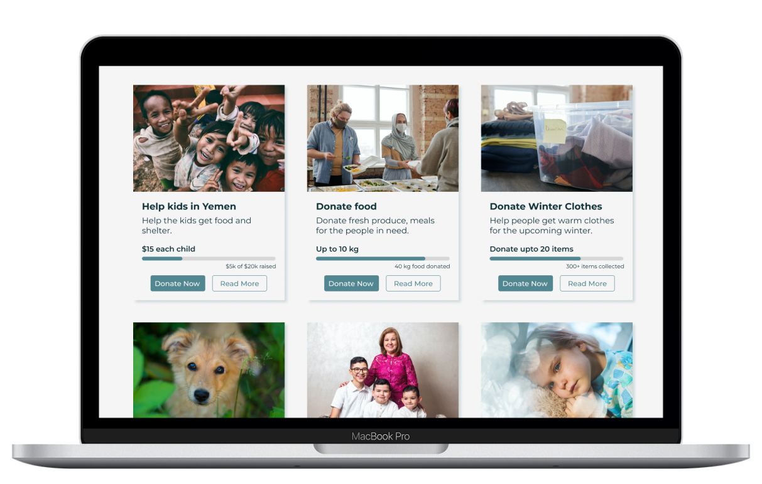
SITEMAP & PROTOTYPES
Figma Prototypes
Donation Drives

Slide 20
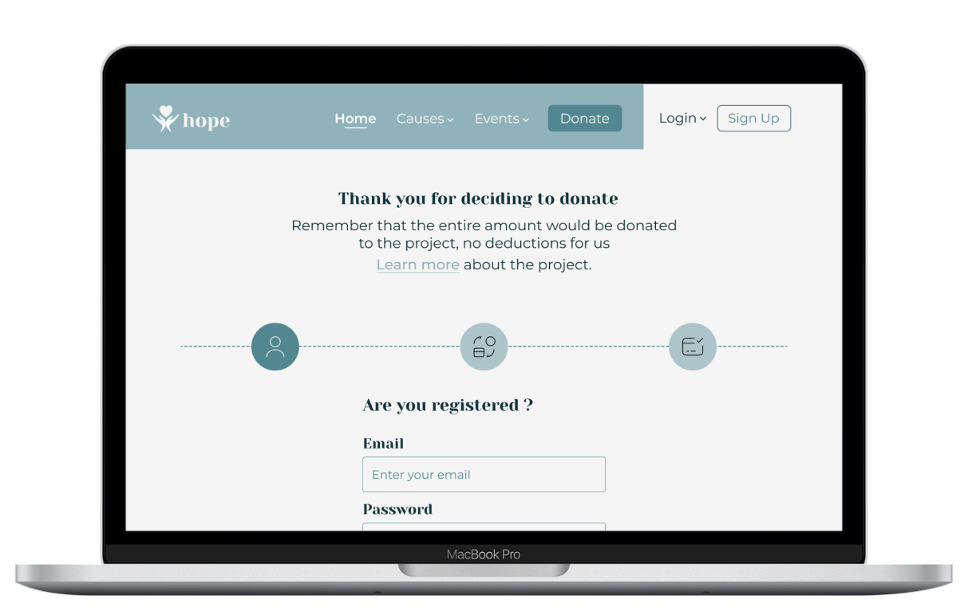
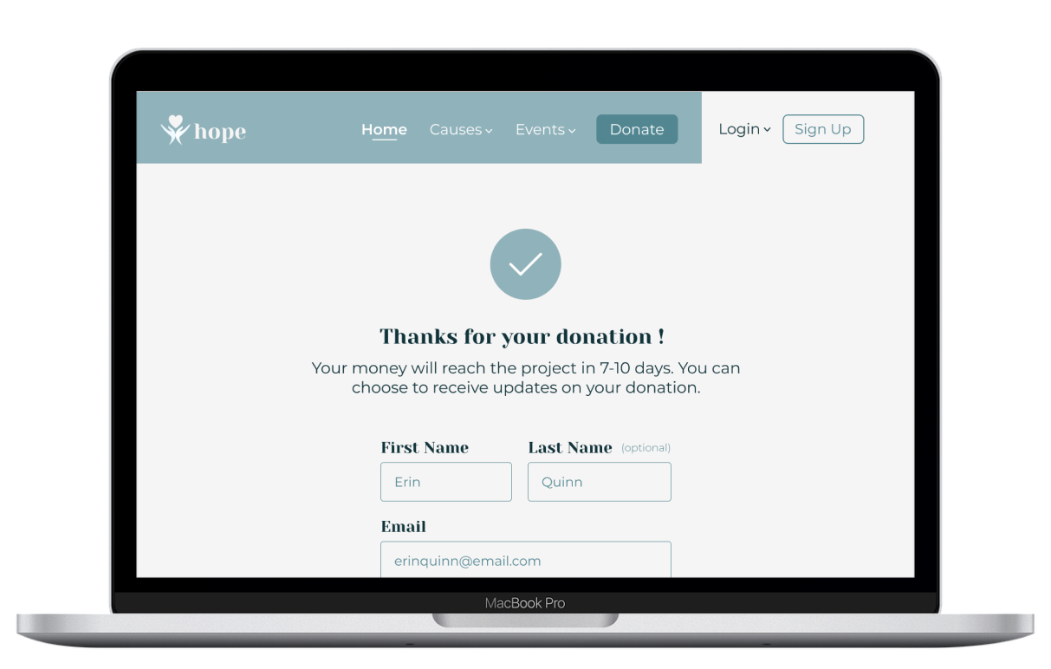
SITEMAP & PROTOTYPES
Figma Prototypes
Payment Flow

Slide 21
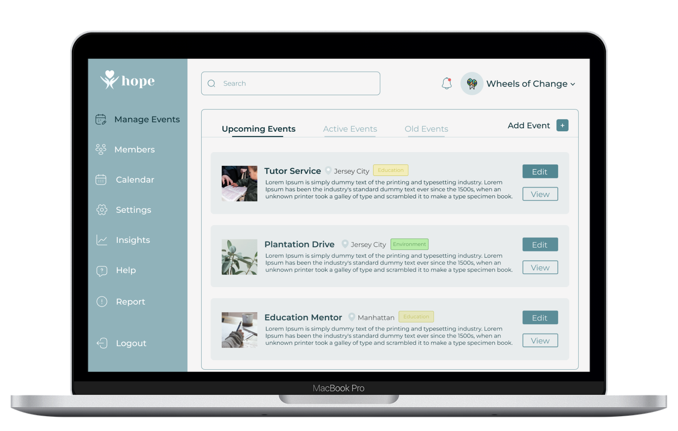
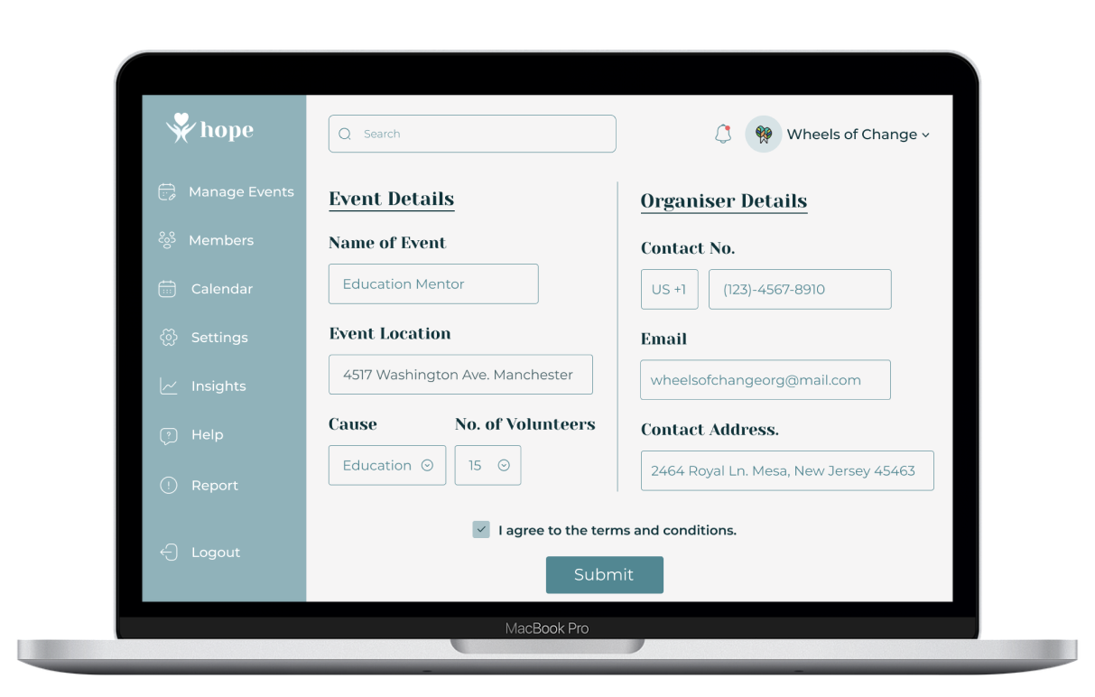
SITEMAP & PROTOTYPES
Figma Prototypes
Organization Dashboard

Slide 22
USABILITY STUDY
Research Objectives
01
Did we make the website trustworthy enough for users looking to volunteer and donate?
Did we make the website trustworthy enough for users looking for a platform to post their events?
Credibility
02
Can users easily search and apply for volunteering events and donation drives?
Can organizations easily post their events, update, and track them accordingly?
Usability
03
What is a user focusing on when looking to volunteer or donate?
What is an organization focusing on when looking to recruit volunteers or collect donations?
User Behavior

Slide 23

USABILITY STUDY
Participation Recruitment
01
Student
Volunteers
Working Adult
02
Student
Donors
Working Adult
03
Organization
Working Adult

Slide 24
USABILITY STUDY
Research Methodology
01
Usability Interviews
Methodology
Contextual
02
One-on-one, with a facilitator and note-taker
Facilitation & Environment
In person or via zoom
Quiet room at the library or at home
Use of a Mac or Window laptop
03
Structure
General and contextual questions
Usability questions (each segment)
Notes:
Overview of
methodology
Usability interviews would be conducted on the participants mentioned by making the user run through the core tasks relevant to their segment followed up by questions.
Contextual interviews will be conducted to understand what motivates users to participate in volunteering events or donate to specific causes, also, how organizations recruit skilled people to support their initiatives.
Facilitation
The interviews would be conducted 1-1 in person or online via zoom, with 1 facilitator and 1 note-taker.
Test environment
The website would be tested on Macbook and Windows laptops Location will be at school library, at home, and at a public library.
Study structure
The study is divided into 5 sections. The users would be asked a set of general questions followed by usability questions. The test is further divided into 3 segments for the volunteers, donors, and organization.

Slide 25

USABILITY STUDY
Usability Testing - Results
Home page design satisfies user needs
Credibility is addressed for volunteers and organizations
Information flow is well organized
Detailed informations and visuals of events support causes
Using causes for filtering is preferred
Participants did not require constant assistance to navigate through the page.
Future improvements are analyzed and provided recommendations
Notes:
Overview of
methodology
Usability interviews would be conducted on the participants mentioned by making the user run through the core tasks relevant to their segment followed up by questions.
Contextual interviews will be conducted to understand what motivates users to participate in volunteering events or donate to specific causes, also, how organizations recruit skilled people to support their initiatives.
Facilitation
The interviews would be conducted 1-1 in person or online via zoom, with 1 facilitator and 1 note-taker.
Test environment
The website would be tested on Macbook and Windows laptops Location will be at school library, at home, and at a public library.
Study structure
The study is divided into 5 sections. The users would be asked a set of general questions followed by usability questions. The test is further divided into 3 segments for the volunteers, donors, and organization.

Slide 26
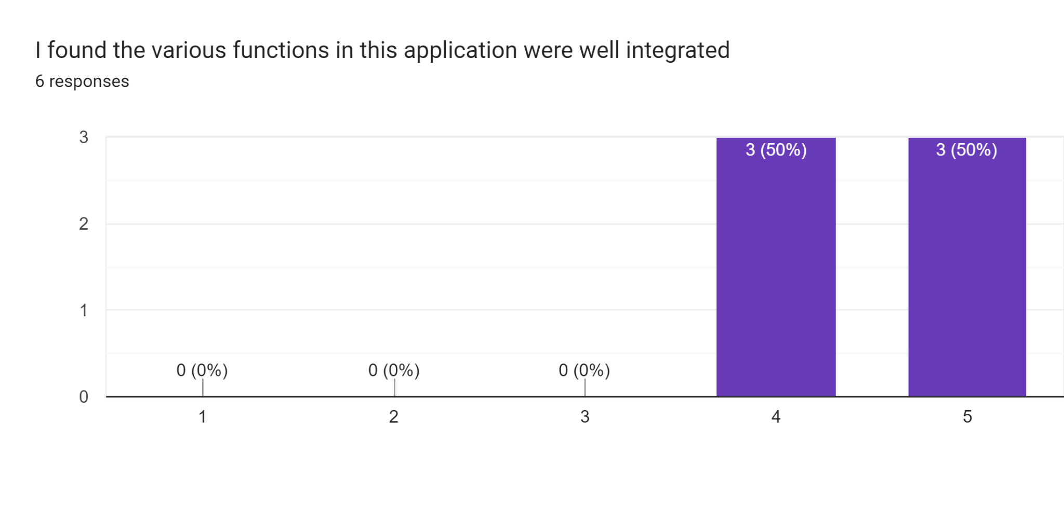
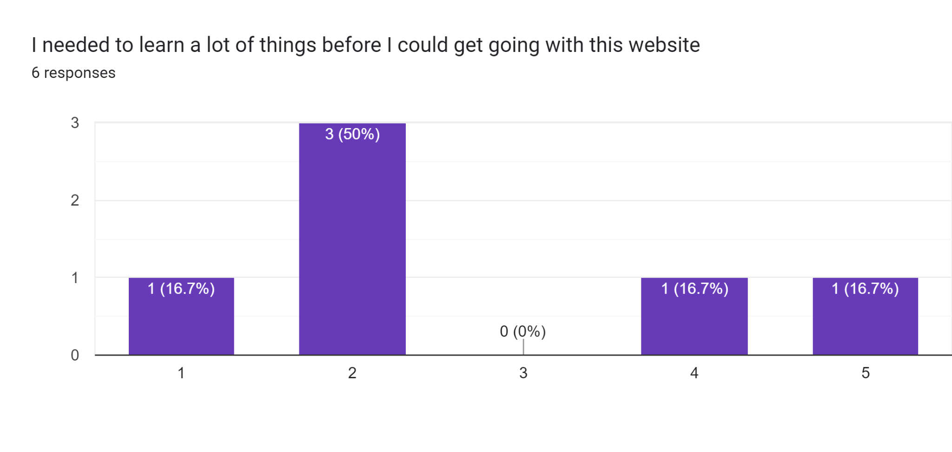
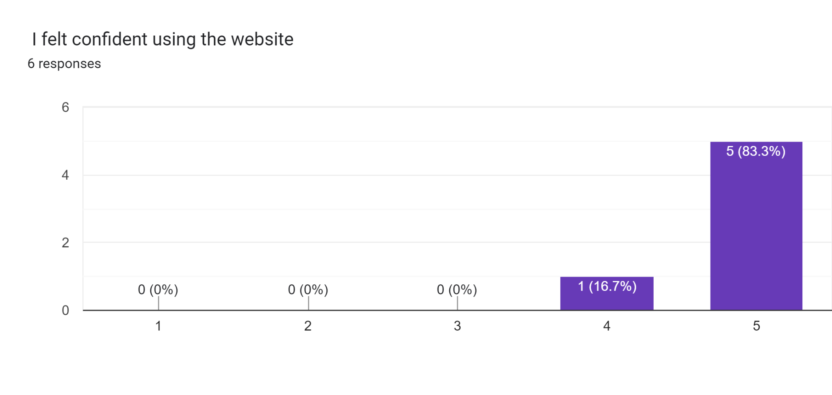
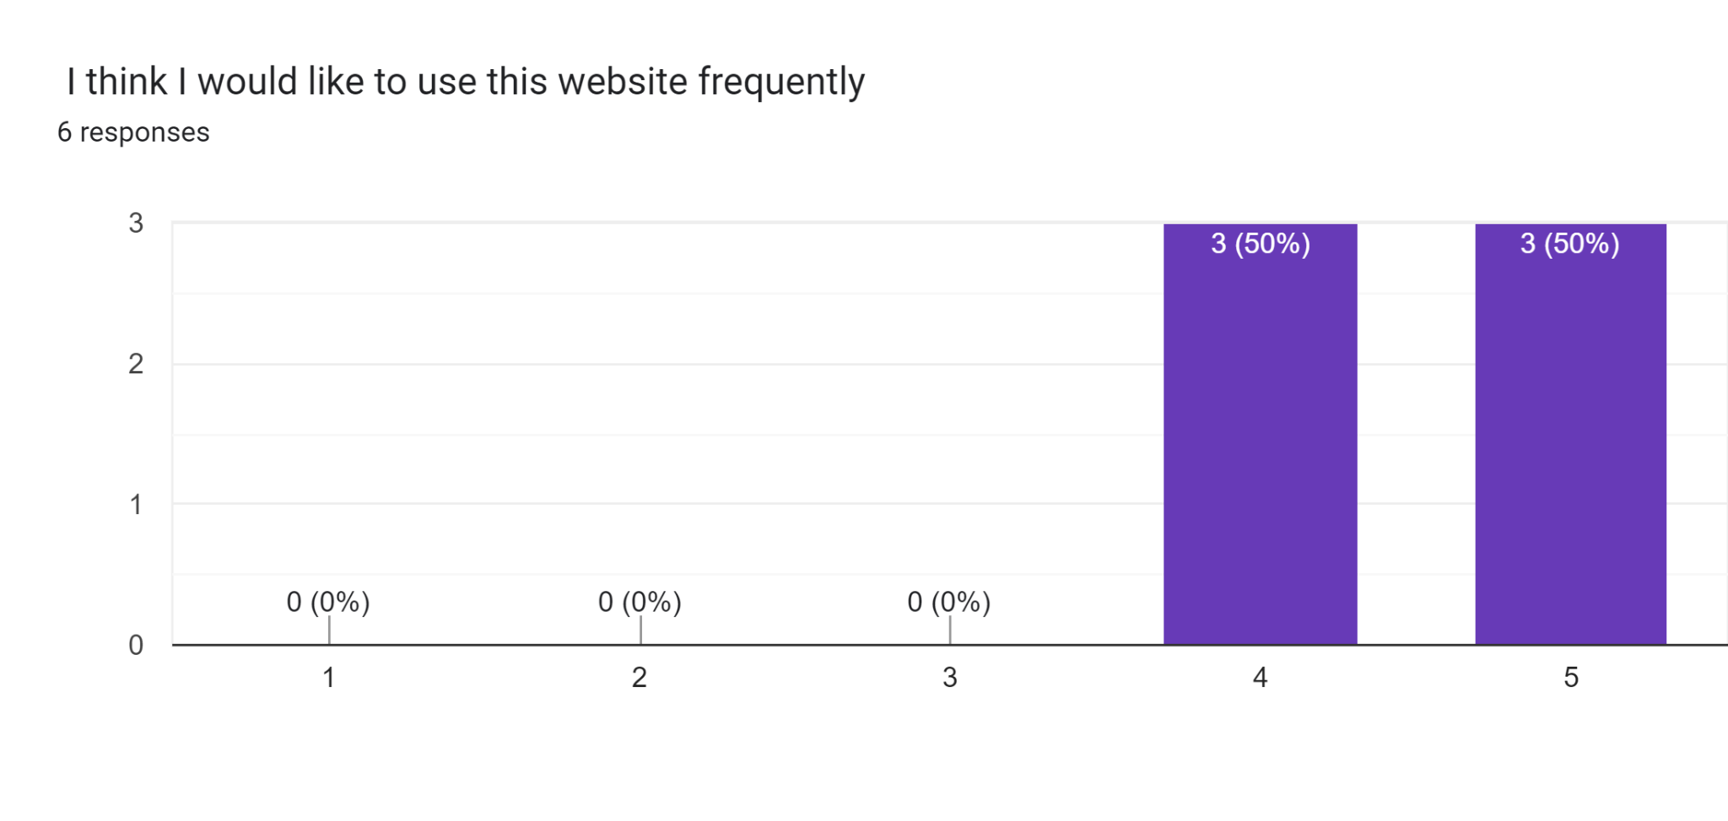
Usability Testing - Results
USABILITY STUDY
Note: The scale used is 1 to 5, where 1 is “Strongly Disagree” and 5 is “Strongly Agree”

Slide 27

CONCLUSION
Improvements in the future
Add certification of accomplishment for volunteers
Provide volunteers information to the organizations
Improvements with filters using keywords, causes, location, date
Add a location option so that the users can calculate the distance and find the events within their desired location
Include more input fields when adding a event like dates, location, pictures etc.
Add the contact information of the organization at the event/drive page
Research on opportunities to built a community between volunteers, donors and organizations

Slide 28

Conclusions
This website was created to bridge the gap between the potential organizers and volunteers
We made considerate improvements in response to findings from user research
We addressed credibility concerns for different user segments
We plan on incorporating new features based on the usability testing analysis
We believe our website offers enough potential to develop in the near future with extended user research

Slide 29

Thank You !

